Slide 1

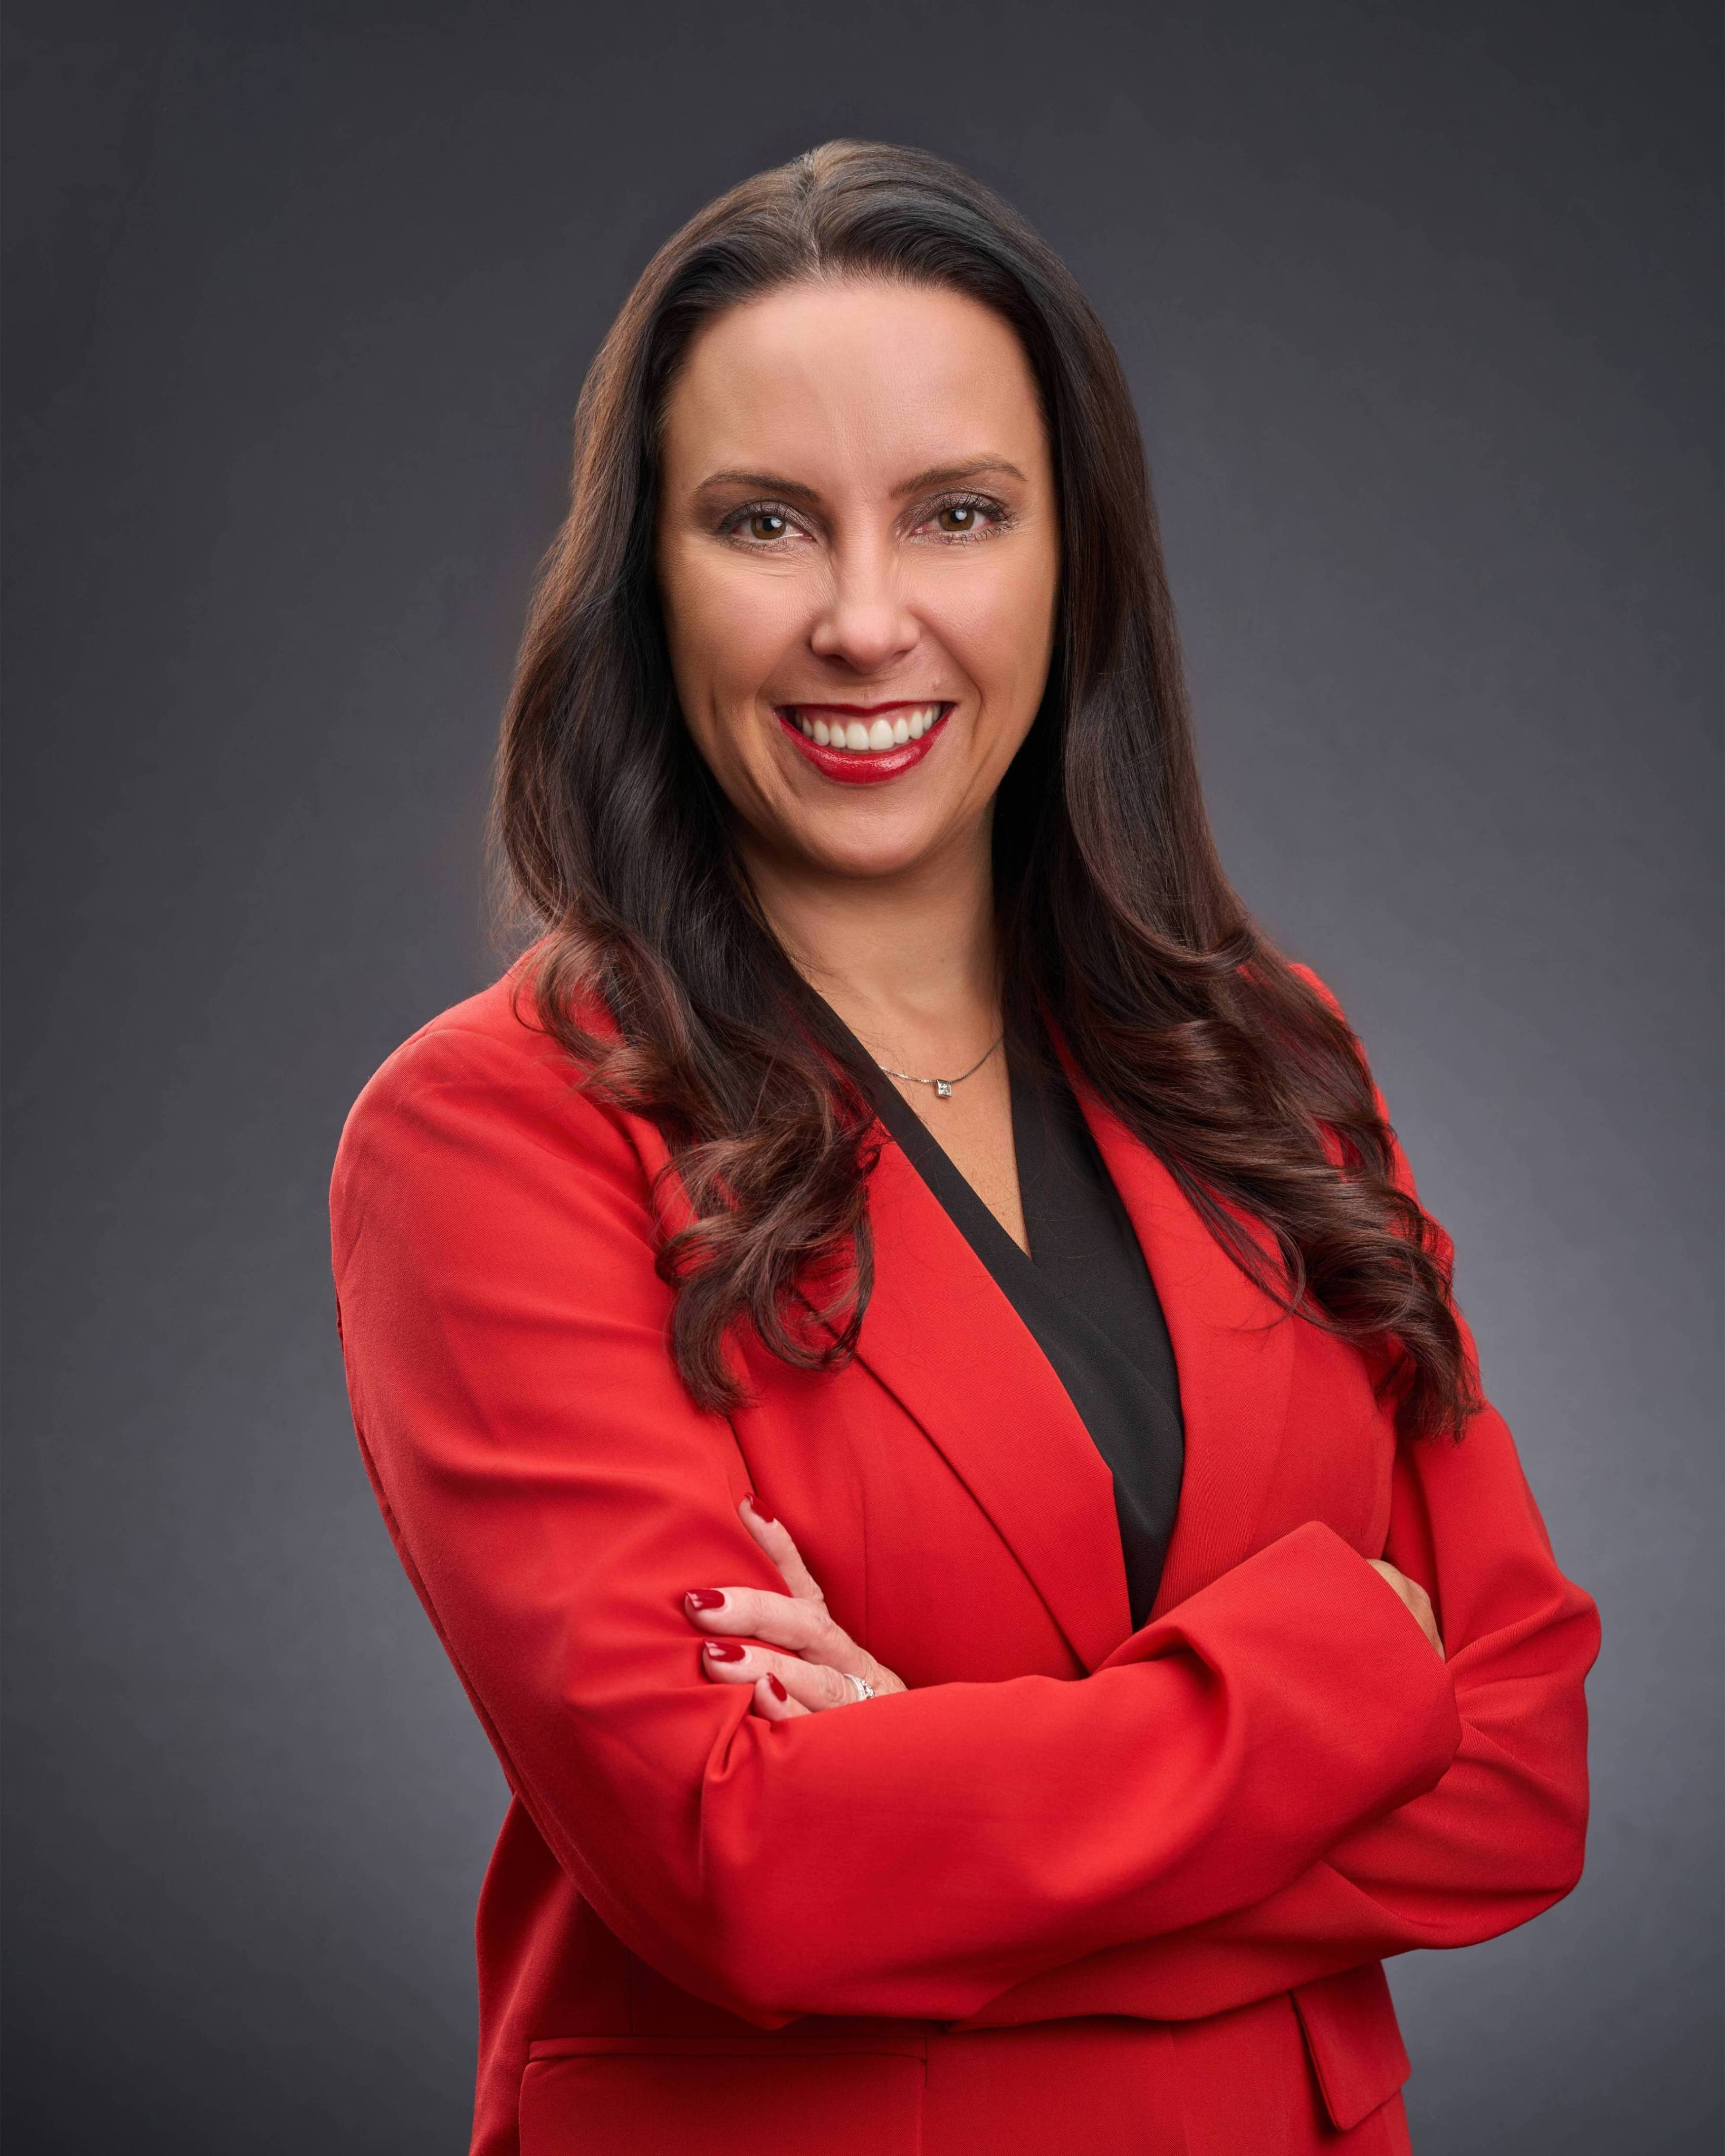
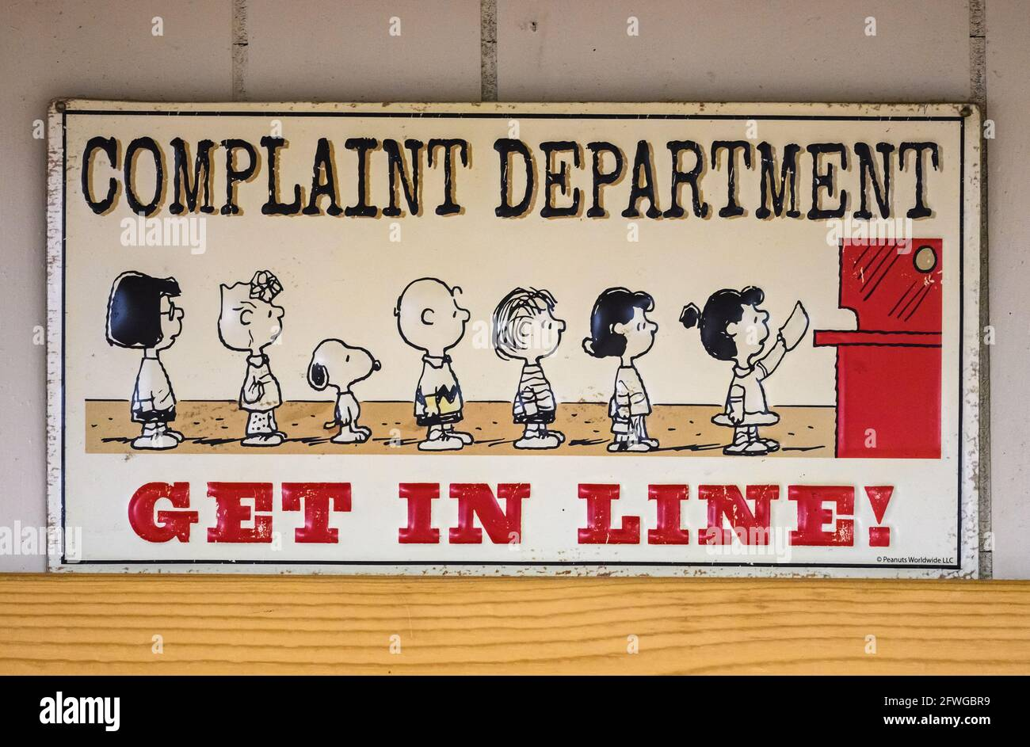
Board of Revision
Gary D. Zeigler II
  Commercial Staff Appraiser
    21 years on staff
  gdzeiglerjr@starkcountyohio.gov
  Board Hearing Officer
Notes:
Introduce yourself and explain the purpose of this session.

Slide 2
Stark County Stats on Appeals
2024 BOR's
Total BORs: 1448 (est. 1% of total RES/AG parcels)
Residential/Ag: 1070
Reduction: 844
No Change: 208
Increase: 18
Average Value: 364,852
Average Reduction: 20%
Com: 378 (1.35% COM/IND parcels)
Reduction: 266
No Change: 77
Increase: 35
Average Value: $2,284,448
Average Reduction: 35%
Notes:
Explain why these procedures matter and their impact on BOR cases.

Slide 3
Why does the BOR Matter
BOR decides property valuation when appealed, classification, exemptions (CAUV) — material tax consequences
Fast, evidence-driven forum with major settlement leverage
Notes:
Explain why these procedures matter and their impact on BOR cases.

Slide 4
BOR Powers
Quasi-Judicial Board
  Administer Oaths
  Hear testimony from property owners, managers, appraisers, executives
  We don’t issue subpoenas but can request for more information (ask the owner to submit a copy of the bank appraisal)
  Burden of Proof: complainant (property owner or BOE)
  Owner can appeal to BTA
Notes:
Explain why these procedures matter and their impact on BOR cases.

Slide 5
Who is on the Board
County Auditor, County Commissioner, County Treasurer (Auditor = secretary)
Boards must meet publicly; Board may appoint staff/experts per Tax Commissioner.
Notes:
Highlight key statutes and emphasize adherence to legal standards.

Slide 6
Legal Framework
Statutory Foundations (key ORC sections)
  ORC 5715.10: valuation/examination powers; examine witnesses under oath.
  ORC 5715.11: mandatory duty to hear properly filed complaints.
  ORC 5715.13: written, sworn application required to decrease valuation.
  ORC 5715.19: who may file, deadlines, one-filing rule, third‑party limits.
  ORC 5715.20: notice of decision — mailing starts appeal clock.
  ORC 5715.271: burden of proof on complainant for valuation/exemption claims.
  ORC 119.09: appointment, powers, report/recommendation duties of referees/examiners.
  ORC 102.03: ethics/conflict-of-interest prohibitions.
Notes:
Highlight key statutes and emphasize adherence to legal standards.

Slide 7
Jurisdiction & Filing Rules
BOR jurisdiction confined to issues pleaded in complaint.
Filing window: typically, by March 31 (postmark controls mailed filings); strict calendar.
One‑filing rule with narrow exceptions (sale, casualty of property, substantial change (e.g. retail tenancy).
Third‑party complaints (Board of Education) and municipal filings have heightened procedural/authorization requirements.
Corporations must be represented by licensed counsel
Notes:
Highlight key statutes and emphasize adherence to legal standards.

Slide 8
Third-Party Complaints
H.B. 126 passed in July 2022 effectively setting limits on the Board of Education (BOE) filing an appeal
  Prior to this legislation, the BOE had no limits in filing
H.B. 126: limits the BOE’s complaints to the requested sale prices increases must exceed $500,000 and 10% higher than the county auditor’s value.
No Private agreements with taxpayers (i.e., out of court agreements)
BOE loses the right to appeal to the Board of Tax Appeals (BTA), unless they own the property
If the BOE intends to file a complaint or counter-complaint, the BOE must pass a formal resolution.
  BOE are finding ways around the BTA by filing straight to the Court of Common Pleas seeking review of ORC 2506.01:
  However, Cuyahoga and Delaware County courts held that the BOE does not standing to appeal BOR decisions.
Notes:
Highlight key statutes and emphasize adherence to legal standards.

Slide 9
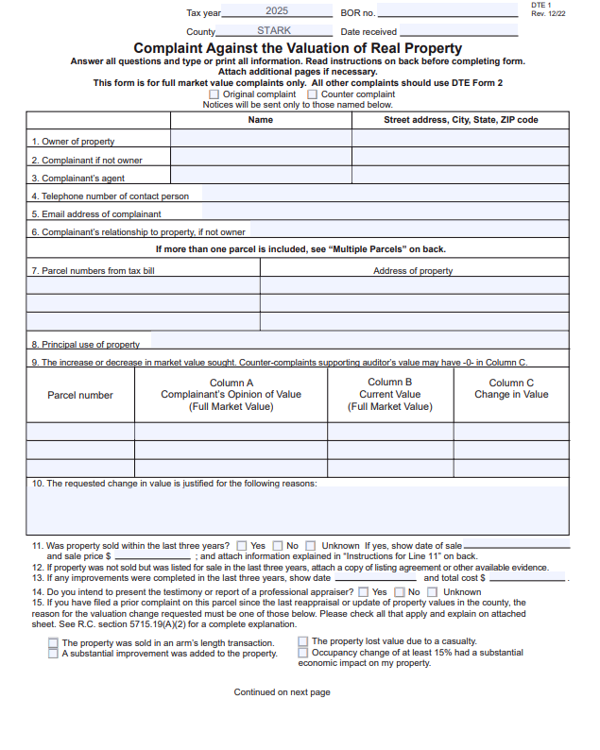
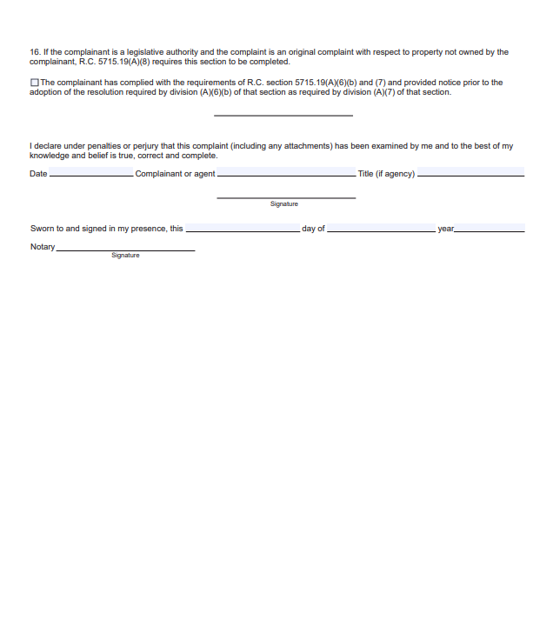
Notes:
Highlight key statutes and emphasize adherence to legal standards.

Slide 10
HypO 1
Client’s 60-unit apartment complex is valued at $5 million by the county with no counter-complaint from the BOE. Client says no way, it’s worth between $3-$4 million and does not want to get an appraisal because they are already spending money on legal representation.
What do you do?
Create your own analysis as an attorney and submit that to the Board
Decline assignment because you have other things to do
Illustrate to the client the Cost-Benefit of getting an appraisal.
Rely on other tax comparables from other similar properties in the county.
Notes:
Highlight key statutes and emphasize adherence to legal standards.

Slide 11
HypO 2
Client comes in and states that he/she has an appraisal for the appeal that is lower than the bank appraisal that was just completed for a refinance loan.
Do you submit the bank appraisal, fee appraisal or both?
Just submit the fee appraisal because it is for the intended use for the BOR members
Submit both and hope for the best
Say that the client never received a copy of the bank appraisal
Notes:
Highlight key statutes and emphasize adherence to legal standards.

Slide 12
HypO 3
Client comes in and states that their property in no way shape or form has gone up 70% in one year after a reappraisal.
Advise your client?
A. Say, “Yep! I agree, no way it went up, so I will handle this and get you a reduction!”
Bring in your own evidence that you have collected as an attorney to the BOR hearing
Tell your client, “before you file, let me research that with a connection I have in the real estate market”
Immediately engage an appraiser
Notes:
Highlight key statutes and emphasize adherence to legal standards.

Slide 13
Options other than Board of Revision
The Stark County Auditor’s office opens an Informal Appeal process mid-August until October 1st (dates can change)
The Commercial Department alone, with 3 staff members, researched over 800-1000 informal appeals with the 2024 reappraisal
Stark County is a leading performer amongst other counties in being proactive with taxpayers, especially, with the informal appeal process.
Notes:
Highlight key statutes and emphasize adherence to legal standards.

Slide 14
The Key Takeaways
Stark County Auditor is ALWAYS here to answer questions and guide you in filing a Board of Revision appeal
If you should file an appeal and forget to put something of material value on the appeal, please contact our BOR Department. Don’t wait until the appeal day to say something
But most importantly remember: This is a fluid process that should be an open and productive discussion with the Board members and BOE counsel.
Notes:
Highlight key statutes and emphasize adherence to legal standards.

Slide 15

Questions
Contact Information:
  gdzeiglerjr@starkcountyohio.gov
  Board of Revision Department:
    BOR@starkcountyohio.gov
    Or call 330-451-7100
Notes:
Highlight key statutes and emphasize adherence to legal standards.

